Slide 1

CSC351-Operating System
Week-1 Lecture-2
Semester 05
                Prepared by:
                M. Shoaib

Slide 2
Agenda for today
Single-user systems
Batch systems
Multiprogram systems
Time-sharing systems
Distributed systems
Real-time systems
Mobile OS
Interrupts, traps, and signals
CPU, I/O, and memory protection Interactive

Slide 3
Single user operating systems
Personal computers – computer system dedicated to a single user.(many but 1 at a time)
Interactive(Accepting input from a human. Interactive computer systems are programs that allow users to enter data or commands. Most popular programs, such as word processors and spreadsheet applications, are interactive.
A non interactive program is one that, when started, continues without requiring human contact. A compiler is a non interactive program)
User convenience and responsiveness.

Slide 4
Single & Multi user Operating systems
Feature | Single-User Operating System | Multi-User Operating System
Number of Users | Supports only one user at a time | Supports multiple users simultaneously
Resource Sharing | No sharing – all resources used by one person | Resources (CPU, memory, storage) are shared among users
Complexity | Simple and easy to use | More complex, requires advanced management
Examples | MS-DOS, Windows (personal editions), macOS, Android, iOS | UNIX, Linux (server editions), Windows Server, Mainframes
Cost | Generally cheaper | More expensive (requires stronger hardware & licensing)
Performance | Optimized for a single user’s tasks | Performance depends on resource allocation among users
Use Case | Personal computers, laptops, smartphones | Servers, mainframes, enterprise systems

Slide 5
Batch Operating systems
First Fundamental system.
User ≠ operator
Reduce setup time by batching similar jobs
Automatic job sequencing – automatically transfers control from one job to another.
Resident monitor :
  initial control in monitor
  control transfers to job
  when job completes
  control transfers back to monitor
  User → Batch Jobs → Batch OS → Execution (Output)
Notes:
Examples of Batch OS: payroll system, bank statements, data entry, etc.

Slide 6
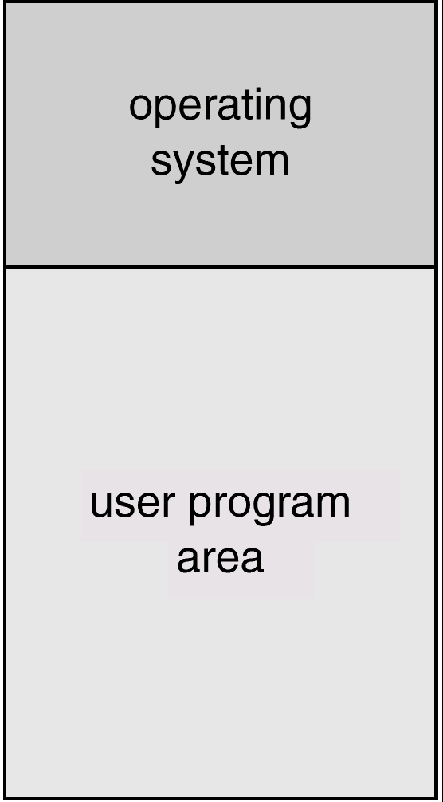
Memory layout of batch systems
OS in upper part → controls the system.
User program area → executes user applications

Slide 7
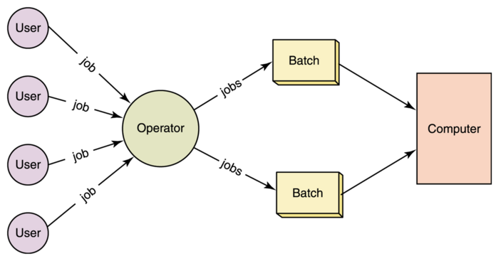
Batch system (conti…)

Slide 8
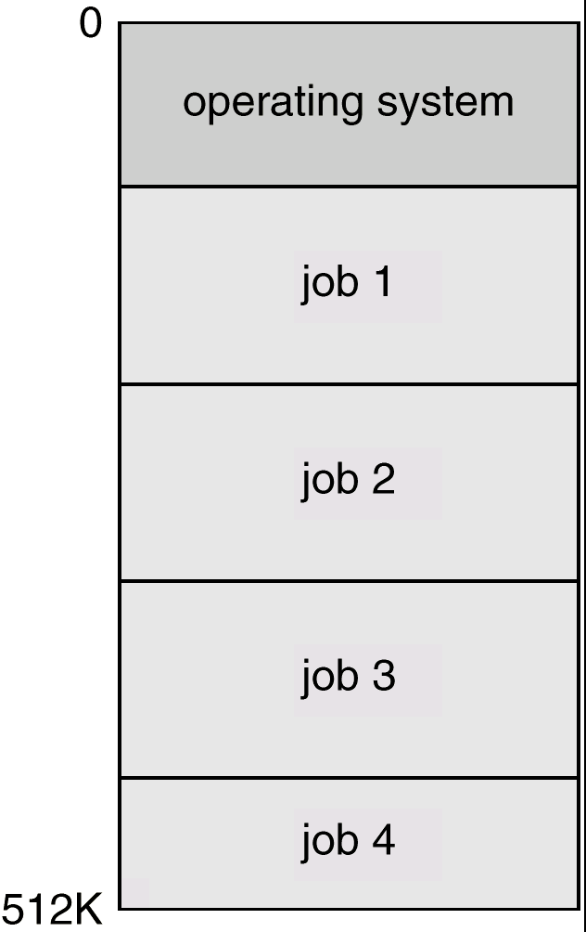
Multi-programmed systems (non preemptive)
Sharing the processor, when two or more programs reside in memory at the same time, is referred as multiprogramming
Multiprogramming increases CPU utilization by organizing jobs so that the CPU always has one to execute.
Several jobs are kept in main memory at the same time, and the CPU is multiplexed among them.
Multiprogramming operating systems monitor the state of all active programs and system resources using memory management programs to ensures that the CPU is never idle, unless there are no jobs to process.

Slide 9


Multiprogrammed Systems
Example: Two processes P1 and P2 with CPU and I/O bursts of one time unit each

Slide 10
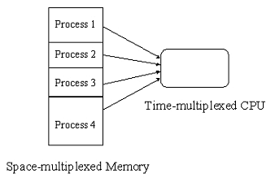
Os features needed for Multiprogramming
Spooling (Simultaneous Peripheral Operation On-Line)(put job in buffer)
Memory management
CPU scheduling

Slide 11

Time sharing systems
A multi user and multi process system.
An interactive system with multiprogramming
To obtain a reasonable response time, jobs may have to be swapped in and out of main memory.
UNIX, Linux, Widows NT server, and Windows 2000 server

Slide 12
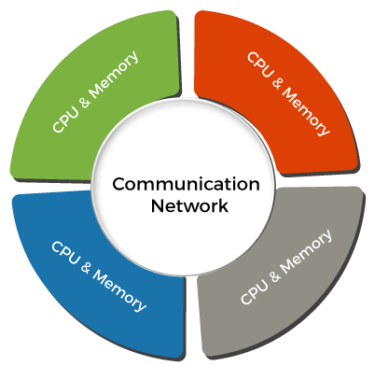
Distributed Operating System
Distributed systems use many central processors to serve multiple real-time applications and users. As a result, data processing jobs are distributed between the processors.
It connects multiple computers via a single communication channel. Furthermore, each of these systems has its own processor and memory.
Additionally, these CPUs communicate via high-speed buses or telephone lines. Individual systems that communicate via a single channel are regarded as a single entity. They're also known as loosely coupled systems.

Slide 13
Real Time systems
A data processing system in which the time interval required to process and respond to inputs is so small that it controls the environment
the time taken by the system to respond to an input and display of required updated information is termed as the response time
A real-time operating system must have well-defined, fixed time constraints, otherwise the system will fail such as controlling scientific experiments, medical imaging systems, industrial control systems, and some display systems. Plane landing. Ventilators.
Real-Time systems may be either hard or soft real-time.

Slide 14
Real Time systems
Hard real-time systems:
  Secondary storage limited are absent, data stored in short term memory, or read-only memory (ROM).coz time is short
  No virtual memory—time cannot be “wasted” on translation of logical to physical addresses.
  OS code structured for efficiency
  Plane landing systems, process control in nuclear power plants, ventilators, etc.

Slide 15
Real time systems (Cont..)
Soft real-time systems
  Output should be produced within the given time constraints but if it is not, Missing the deadline may cause inconvenience, delay, or reduced performance, but it won’t cause a disaster, injury, or system failure.
  Useful in applications (Live Video Streaming) requiring advanced operating-system features
Mobile Communication
Music Playing Robots
Weather Station

Slide 16
Mobile OS
OS for smartphones, tablets, and PDA’s. It is a platform on which other applications can run on mobile devices.
Examples of the Mobile OS: Android OS, ios, Symbian OS, and windows mobile OS

Slide 17
Interrupts
Interrupts are signals sent to the CPU by external devices, normally I/O devices. They tell the CPU to stop its current activities and execute the appropriate part of the operating system
After the interrupt signal is sensed, the computer either resumes running the current program or begins running another program.
An operating system usually has some code that is called an interrupt handler. The interrupt handler prioritizes the interrupts and saves them in a queue if more than one is waiting to be handled.

Slide 18
Interrupts, Traps and Signals
Interrupt---an event generated by a device in a computer to get attention of the CPU(from hardware devices)
Trap—an event by the CPU itself as it executes a program
Signal—an event generated by a user

Slide 19


Interrupts, trap, signals
If you press any key(keyboard) or moving the mouse…..Example of interrupt
Hardware may trigger an interrupt at any time by sending a signal to the CPU usually by way of the system bus.
Software may trigger an interrupt by executing a special operation called a system call
Answer the Phone
.
.
.
Resume

Slide 20
Interrupts, trap, signals
A process can generate a trap, for example, by dividing a number by zero.
caused either by an error (division by zero or invalid memory access) or by a user request for an operating system service.
A user or a process may generate a signal (an interrupt to a process)

Slide 21
Interrupt handling
In case of interrupt or trap, the CPU invokes a piece of code in the OS to service it, known as interrupt service routine(ISR) or trap service routine(TSR)
In case of signal, the process can take one of the three possible actions , default action as defined by OS, ignore signal, or take a programmer specified action

Slide 22
Interrupt handling (Cont..)
Interrupt transfers control to the interrupt service routine, generally, through the interrupt vector, which contains addresses of all the interrupt service routines.
Interrupt architecture must save the address of the instruction after the interrupted instruction and the CPU state so that execution of the interrupted process may continue after the interrupt has been serviced.

Slide 23
As we have time sharing system so multiple user may be there. Here comes the issue of protection
One user may delete the files of others.
Or may overwrite program in memory

Slide 24
Hardware protection
Dual-Mode Operation
I/O Protection
Memory Protection
CPU Protection

Slide 25
Dual Mode Operation
Sharing system resources requires operating system to ensure that an incorrect program cannot cause other programs to execute incorrectly.
Provide hardware support to differentiate between at least two modes of operations.
  User mode – execution done on behalf of a user.
  Monitor mode (also kernel mode or system mode) – execution done on behalf of operating system.

Slide 26
Dual Mode Operation
Mode bit added to computer hardware to indicate the current mode: monitor (0) or user (1).
When an interrupt or fault occurs hardware switches to monitor mode.
Privileged instructions can be issued only in monitor mode.
Interrupt/fault
monitor
user
set user mode

Slide 27
Reference
To cover this topics , different reference material has been used for consultation.
Operating systems concept by Abraham siberchatz edition 9
Tutorialspoint.com
Google.com

Slide 28
Task
You are developing a real-time monitoring system for a hospital that tracks patients’ vital signs, such as heart rate, blood pressure, and oxygen levels. The system must alert medical staff immediately if a patient's condition become worst.
Questions:
Real-Time Requirements:
Identify which tasks in the monitoring system would be classified as hard real-time and which
would be soft real-time. Justify your classifications.
Interrupts, Traps and Signals
Interrupts vs Traps
Dual Mode Operation

Slide 29
Task
An employee is running a word processor, listening to music, and downloading a file at the same time on a single computer.
The OS of that computer loads multiple programs into memory so they can share CPU time efficiently.
The company also connects several computers together over a network so that tasks like file storage and computation can be shared

